Slide 1

Erik Caldwell, Stanley Nagaoka, Jessia (Jes) Santora, Teasha McCoy

Slide 2
Hi, I’m Mark! I’m moving from New York to San Diego and was wondering what is a good neighborhood to reside?
Notes:
Erik slides

Slide 3
There are a few things I want in my new neighborhood.
Notes:
Erik slides

Slide 4
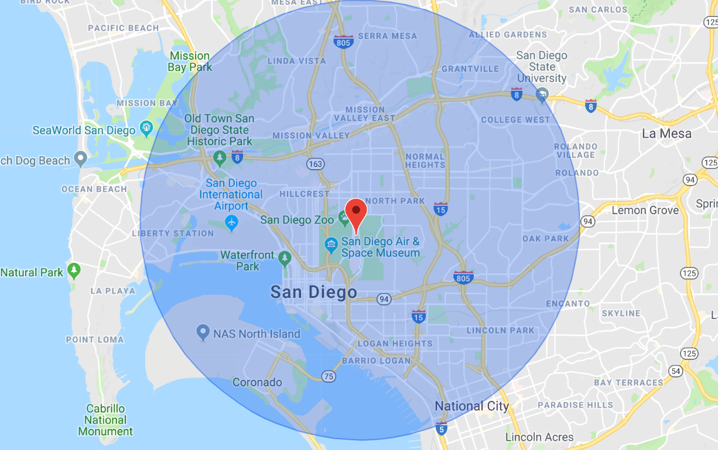
Notes:
Erik slides

Slide 5

Notes:
Erik slides

Slide 6
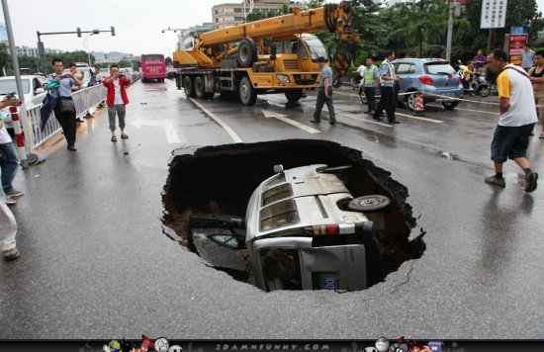
Notes:
Erik slides

Slide 7
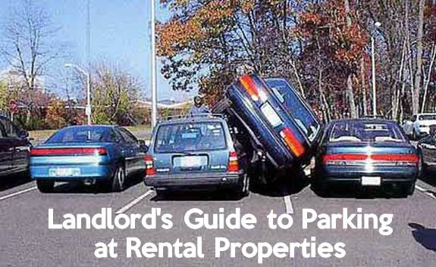
Notes:
Erik slides

Slide 8

Notes:
Erik slides

Slide 9

Notes:
Erik slides

Slide 10
Hi Mark, we can look at 311 data for minor nuances that occur throughout San Diego. With choosing Koala-ty, we can give you an analysis of whiny neighborhoods so you can pick the best place.
Hi Peter, I want to make sure I’m not living in a whiny neighborhood, where should I live?
Notes:
Stanley’s slides

Slide 11
What Data is being used in Analysis?
Notes:
Stanley’s slides

Slide 12

Notes:
Stanley’s slides

Slide 13
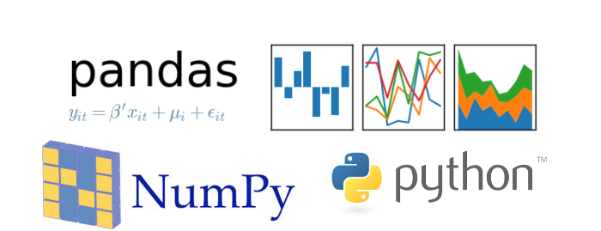
Notes:
Stanley’s slides

Slide 14
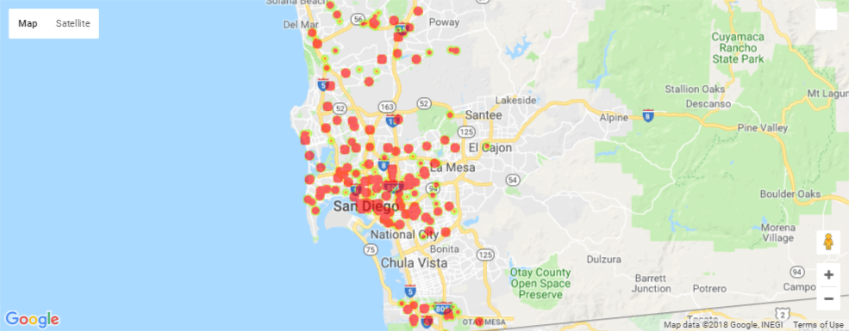
Mapped 311 Calls
Notes:
Stanley’s slides

Slide 15

Notes:
Stanley’s slides

Slide 16
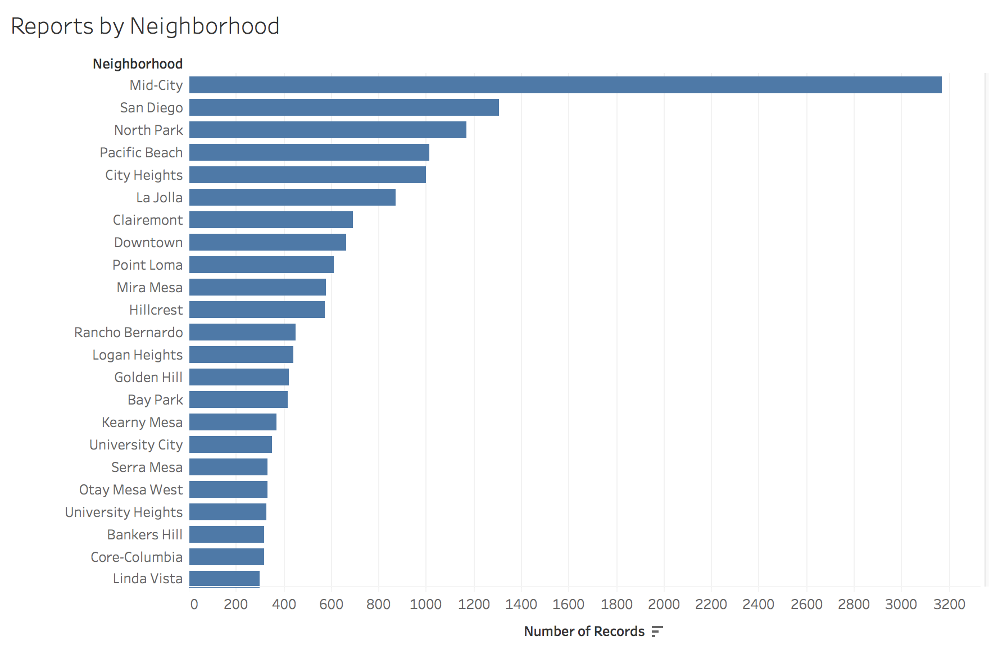
Notes:
Teasha’s slides

Slide 18
Notes:
Teasha’s slides

Slide 20
Notes:
Teasha’s slides

Slide 21

Notes:
Jes’s slides

Slide 22
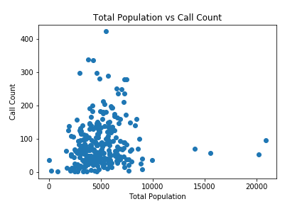
R = 0.1121
Notes:
Jes’s slides

Slide 23
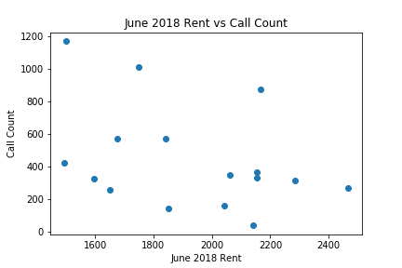
r = -.3811
Notes:
Jes’s slides

Slide 24
Notes:
Jes’s slides

Slide 25
Notes:
Jes’s slides

Slide 26
Notes:
Jes’s slides

Slide 27
Visualizations: Why are these the whiniest neighborhoods?
Connection between home price and # of complaints
Connection between rents and # of complaints
Connection between age and # of complaints
Connection between income and # of complaints
Connection between population density and # of complaints

Slide 28

Notes:
Erik Slides

Slide 29
Wow!... This was really informative. I’m going to live in North Park.
Notes:
Erik Slides

Slide 30
Presentation Outline:
Intro
Mark’s story
Finding the whiniest neighborhoods in San Diego
Call to adventure – narrative
Hiring Koala - ty
What – what is the problem
Data sources
What steps did we take?
So what –
What did did we find?
Visualizations
Now what
But why?
Visualizations
Call to action
If you were Mark
Close
What did Mark do?

